Slide 1
CSCE 5580: Computer Networks
FakeBehalf: Imperceptible Email Spoofing Attacks against the Delegation Mechanism in Email Systems
Name | ID
Kishan Kumar Zalavadia | 11685261
Valapadasu Uday Bhaskar | 11696364

Slide 2
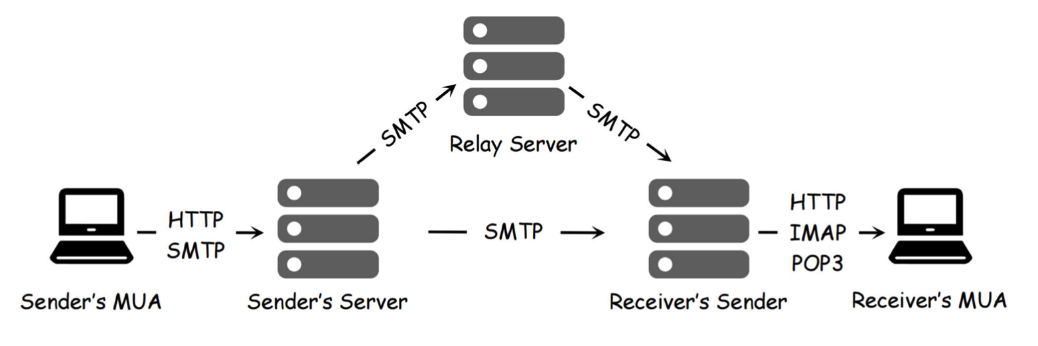
Introduction: Email
Context: Over 347.3 billion emails are sent daily.
Delegation Mechanism: Allows sending emails on behalf of others using the Sender field.
Problem: Vulnerabilities in the Sender field bypass existing security measures (e.g., DKIM, DMARC). Original SMTP lacks sender authentication.
Goal: Analyze these vulnerabilities and propose solutions
Notes:
SMTP: Basic protocol to send email.
SMTP lacks authentication of the email sender.
To address this problem: SPF/DKIM/DMARC

Slide 3
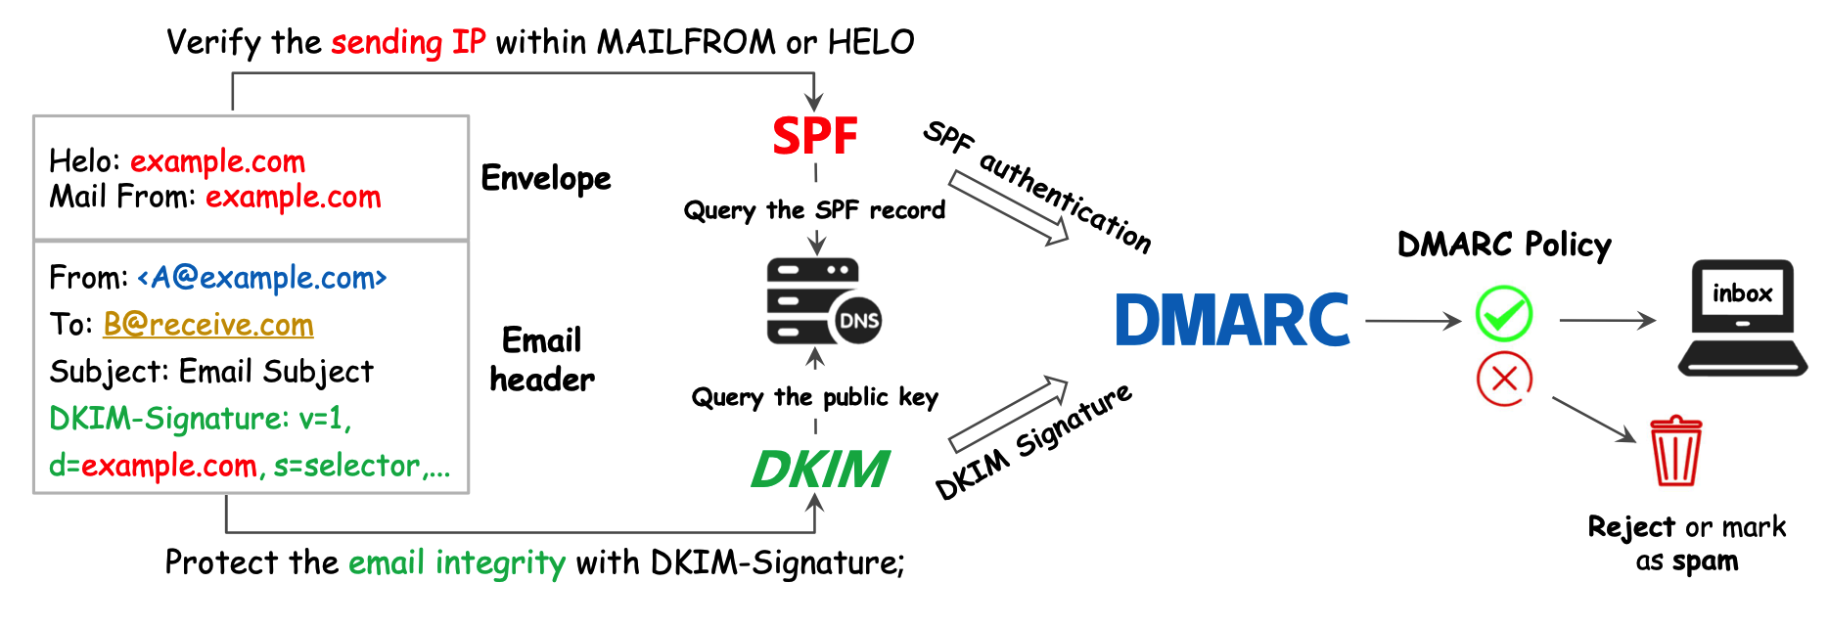
Introduction: Security Extension
Notes:
DMARC: Verifies the consistency
Security extensions are not designed for the delegation mechanism of the email.

Slide 4
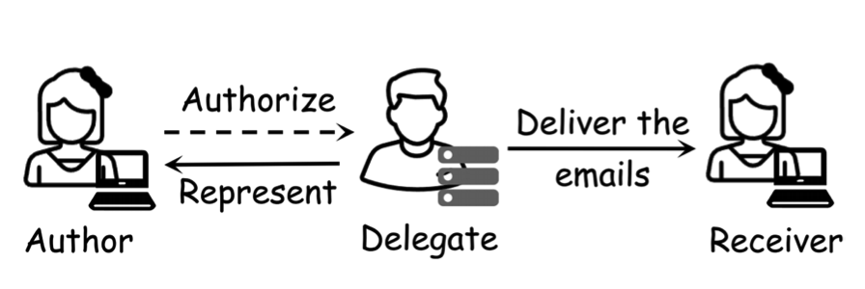
Introduction: Email Delegation
Allows entities to send emails on behalf of the author
The sender field indicates the agent for email delivery (Delegate)
Two key vulnerabilities were identified:
Sender field fabrication
Inconsistent Delegation implementation
Notes:
Sender field is not validated by any security extensions.

Slide 5
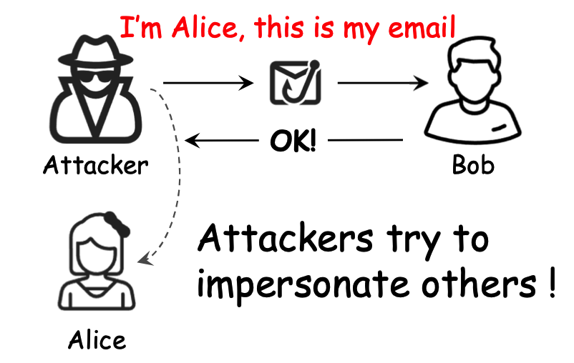
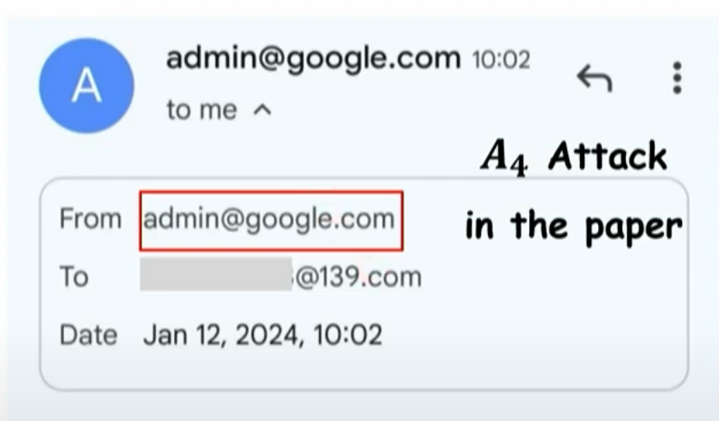
Introduction: Email Spoofing attack
Overview of Techniques
Multi-address From field.
Non-truncated From field.
Multiple From fields.
Angle brackets Parsing.
Encoded addresses.
Fully encoded From field.
Impact: Successfully bypassed authentication in 8/16 providers.
Notes:
Can the delegation mechanism being exploited in Email spoofing attacks?
Multi-address From the field: Adds multiple fake addresses.
Non-truncated From field: Manipulates formatting to mislead.
Multiple From fields: Uses multiple From headers for confusion.
Angle Bracket Parsing: Exploits syntax ambiguities in email parsing.
Encoded Addresses: Hides information using Base64 encoding.
Fully Encoded From field: Entire address encoded to evade checks.

Slide 6
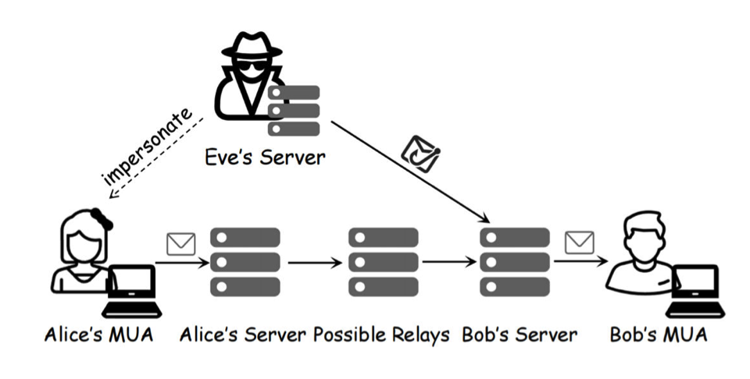
Attack Models
Entities:
Alice (trusted sender), Bob (recipient), Eve (attacker).
How it works:
Eve manipulates the Sender field to impersonate Alice.
Exploits gaps in SPF/DKIM authentication to bypass detection.
Outcome:
Spoofed emails pass checks and appear legitimate to Bob.
Notes:
Model passes the SPF/DKIM security mechanism.
Attacker will not modify the SMTP commands.
The sender domain is fully controlled by the attackers

Slide 7
Security Issues
Vulnerability 1:
Sender field lacks authentication; attackers can arbitrarily fabricate it.
11/16 providers allow spoofed Sender fields without modification.
Vulnerability 2:
Inconsistent Delegation Mechanism implementations.
7/20 clients fail to expose Delegate information, increasing risks.
Notes:
Protocols: The sender field is neglected by the security protocols.
Implementation: Various email providers and clients have different implementations of the delegation mechanism.
Providers: Provides servers: Gmail, Outlook, etc
Client: How we use: Web, App.

Slide 8
Attack Results
Tested: 16 email providers, 20 clients.
Findings:
8 providers are vulnerable to spoofing attacks.
All 20 clients displayed spoofed Sender fields without warnings.

Slide 9
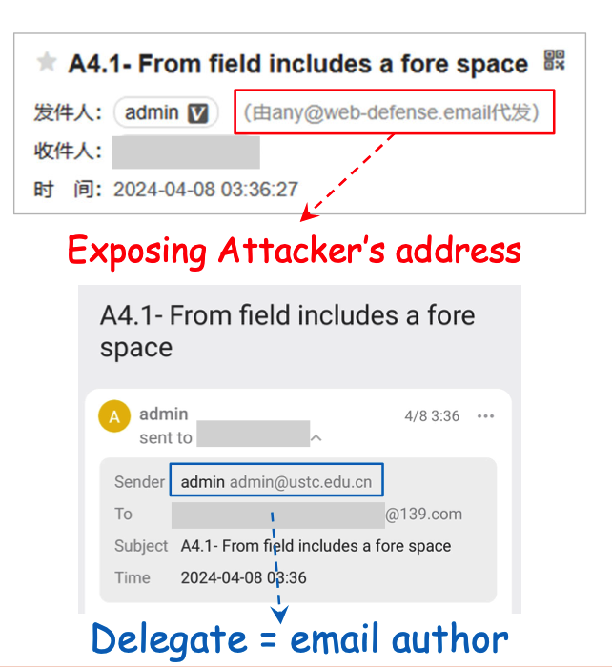
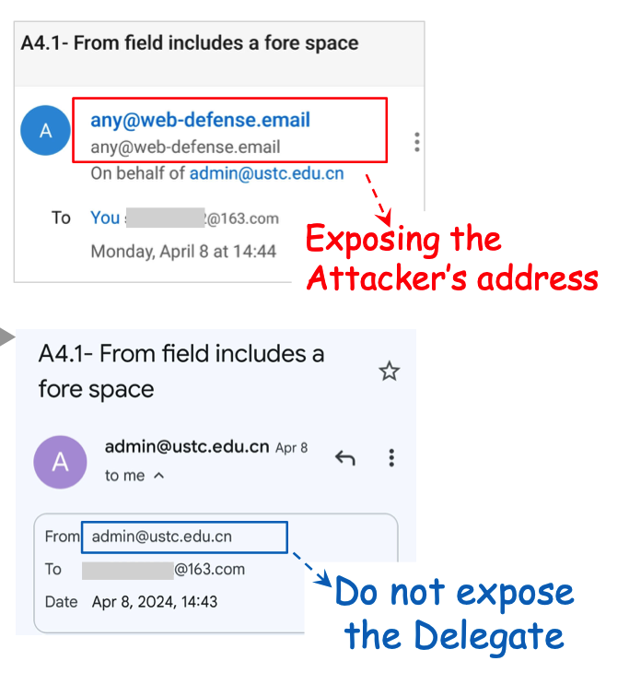
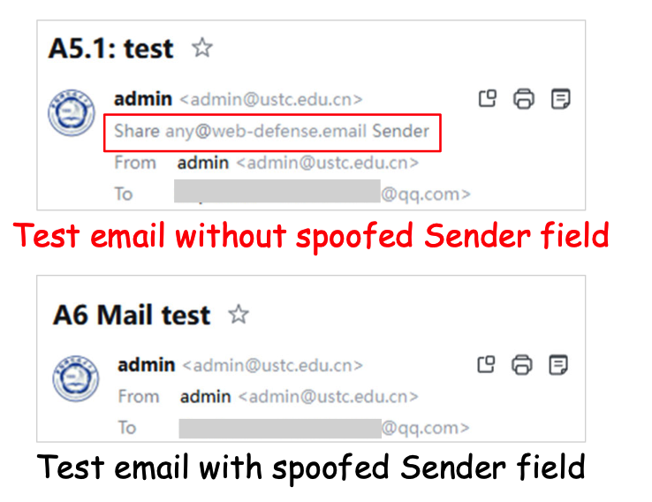
Attack Results (Cont.)
Example Cases:
Case 1: Clients show the wrong Delegate.
Case 2: Servers modify the Sender field but fail to expose Delegate.
Case 3: Web interface issues exposing delegates
Case 1
Case 2
Case 3

Slide 10
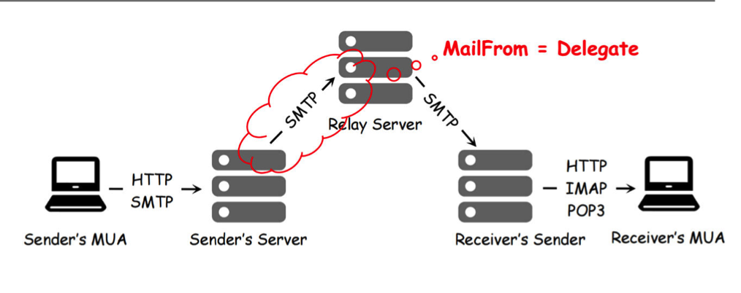
Proposed defensive Mechanism
Validation Scheme for Providers:
Ensure consistency during email transmission between the Sender, From, and MAIL FROM fields.
Authenticate the Sender field in the first SMTP session.
Modify unauthenticated Sender fields to align with MAIL FROM.
Client-Side Improvements:
Display full From field details (e.g., multi-addresses).
Expose Delegate information to users.
Parse additional header fields (e.g., Return-Path).
Issue warnings for suspicious Sender fields.
Notes:
Need validation for the spoofed descendent field.
Modify the spoofed descendent field during the 1st SMTP.

Slide 11

Limitations
Results may only generalize to some email platforms.
Some spoofing methods depend on specific client behaviors.
The evaluation primarily focused on mainstream providers.
Future Work
Expand testing to niche email providers and platforms.
Investigate client-level security improvements to handle spoofing.
Develop advanced methods for detecting spoofed Sender fields in real time.

Slide 12
Conclusion
Delegation Mechanism vulnerabilities expose email systems to spoofing attacks.
Security protocols like SPF/DKIM overlook the Sender field.
Stronger validation, better client-side defenses, and user awareness are critical.
Reference
https://www.usenix.org/conference/usenixsecurity24/presentation/ma-jinrui

Slide 13
Thank You Questions?

